Slide 1
CPSC331 - Spring 2019 Tutorial 07
Khobaib Zaamout

Slide 2


Question 1.a: prove that $f∈Θ(g)$
1) Consider the functions $f, g :ℕ → ℕ$such that $f(n) = 4n^{2} + 2n + 1$and $g(n) = n^{2}$for all $n∈ℕ$.
(a) You were asked to use the definitions of “$O(g)$” and of “$Ω(g)$”, to prove that $f∈Θ(g)$.

Slide 3

Question 1.a: prove that $f∈Θ(g)$
Since the question asks us to utilize the definitions of “$O(g)$” and of “$Ω(g)$”; then we use $Θ$’s Equivalent Definition:
Suppose $f, g :ℝ^{≥0}→ℝ^{≥0}$, or $f, g :ℕ→ℕ$, and that f and g are asymptotically positive. Then $f∈Θ(g)$ if and only if $f∈O(g)$ and $f∈Ω(g)$

Slide 4

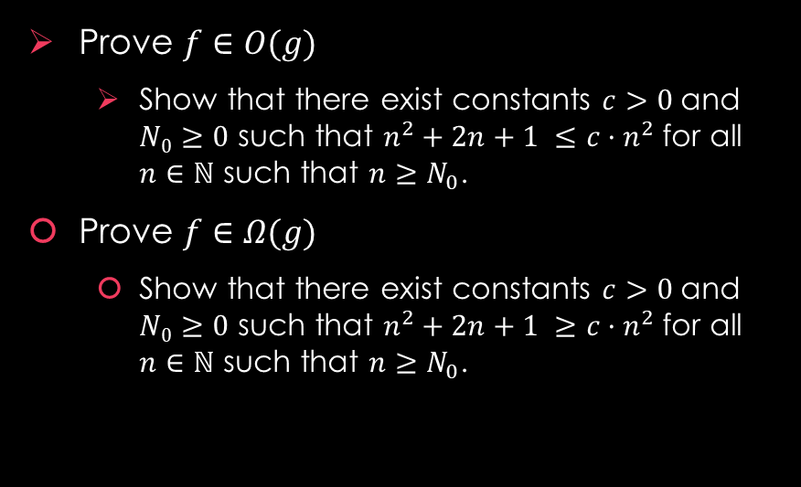
Question 1.a: prove that $f∈Θ(g)$
Work Area:
Background: To prove $f∈Θ(g)$, we need to:
Prove $f∈O(g)$
Show that there exist constants $c>0$and $N0≥0$ such that $n^{2}+2n+1 ≤c·n^{2}$for all $n∈ℕ$ such that $n≥N_{0}$.
Prove $f∈Ω(g)$
Show that there exist constants $c>0$and $N0≥0$ such that $n^{2}+2n+1 ≥c·n^{2}$for all $n∈ℕ$ such that $n≥N_{0}$.

Slide 5
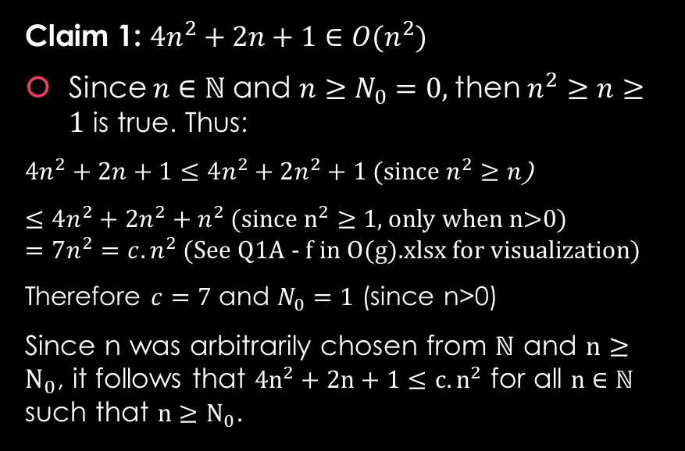
Question 1.a: prove that $f∈Θ(g)$
Work Area:
Background: To prove $f∈Θ(g)$, we need to:
Claim 1: $4n^{2}+2n+1∈O(n^{2})$
Since $n∈ℕ$and $n≥N_{0}=0,$then $n^{2}≥n≥1$ is true. Thus:
$4n^{2}+2n+1≤$ $4n^{2}+2n^{2}+1$ (since $n^{2}≥n$)
$≤4n^{2}+2n^{2}+n^{2}$ (since $n^{2}≥$ 1, only when n>0) $=7n^{2}=c.n^{2}$ (See Q1A - f in O(g).xlsx for visualization)
Therefore $c=7$ and $N_{0}=1$ (since n>0)
Since n was arbitrarily chosen from $ℕ$ and $n≥N_{0}$, it follows that $4n^{2}+2n+1≤c.n^{2}$ for all $n∈ℕ$ such that $n≥N_{0}$.
Prove $f∈O(g)$
Show that there exist constants $c>0$and $N0≥0$ such that $n^{2}+2n+1 ≤c·n^{2}$for all $n∈ℕ$ such that $n≥N_{0}$.
Prove $f∈Ω(g)$
Show that there exist constants $c>0$and $N0≥0$ such that $n^{2}+2n+1 ≥c·n^{2}$for all $n∈ℕ$ such that $n≥N_{0}$.

Slide 6
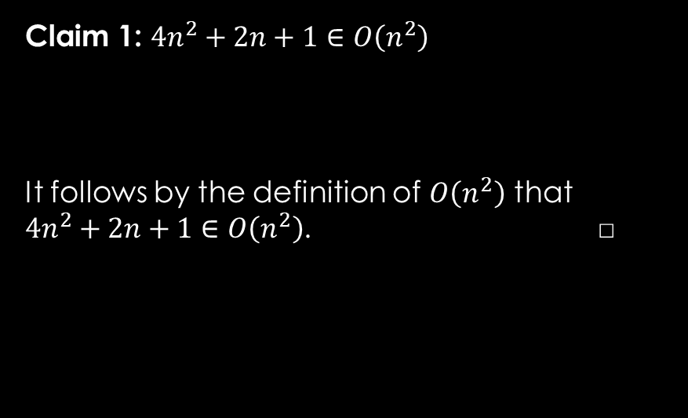
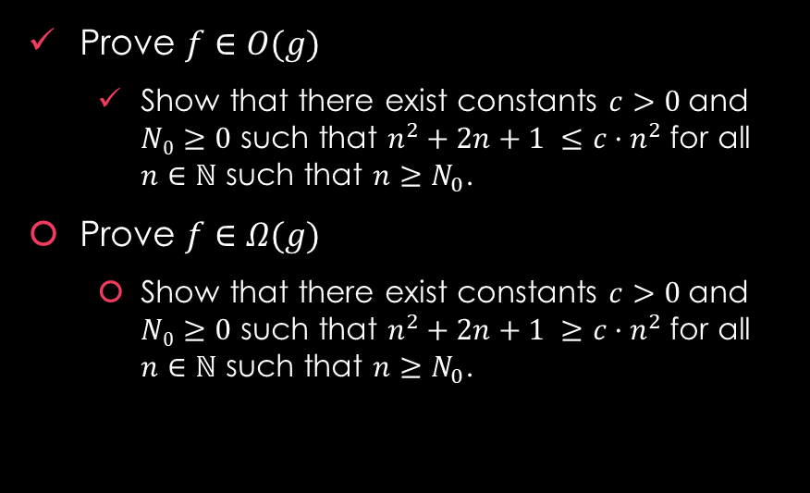
Question 1.a: prove that $f∈Θ(g)$
Work Area:
Background: To prove $f∈Θ(g)$, we need to:
Claim 1: $4n^{2}+2n+1∈O\left(n^{2}\right)$
It follows by the definition of $O\left(n^{2}\right)$ that $4n^{2}+2n+1∈O\left(n^{2}\right)$. □
Prove $f∈O(g)$
Show that there exist constants $c>0$and $N0≥0$ such that $n^{2}+2n+1 ≤c·n^{2}$for all $n∈ℕ$ such that $n≥N_{0}$.
Prove $f∈Ω(g)$
Show that there exist constants $c>0$and $N0≥0$ such that $n^{2}+2n+1 ≥c·n^{2}$for all $n∈ℕ$ such that $n≥N_{0}$.

Slide 7
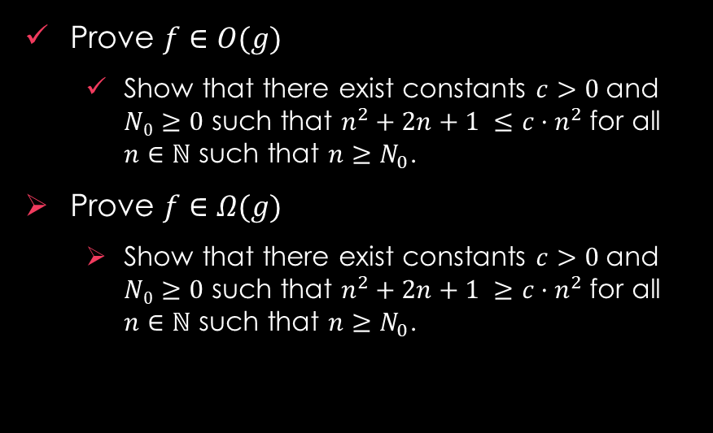
Question 1.a: prove that $f∈Θ(g)$
Work Area:
Background: To prove $f∈Θ(g)$, we need to:
Prove $f∈O(g)$
Show that there exist constants $c>0$and $N0≥0$ such that $n^{2}+2n+1 ≤c·n^{2}$for all $n∈ℕ$ such that $n≥N_{0}$.
Prove $f∈Ω(g)$
Show that there exist constants $c>0$and $N0≥0$ such that $n^{2}+2n+1 ≥c·n^{2}$for all $n∈ℕ$ such that $n≥N_{0}$.

Slide 8
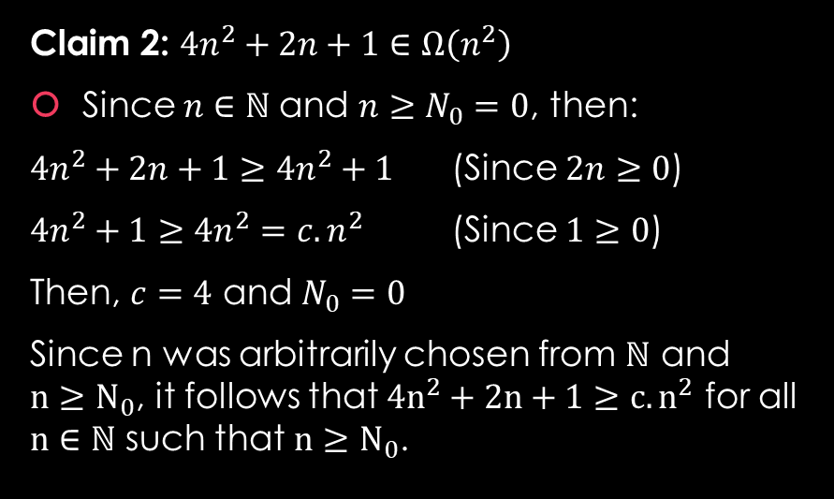
Question 1.a: prove that $f∈Θ(g)$
Work Area:
Background: To prove $f∈Θ(g)$, we need to:
Claim 2: $4n^{2}+2n+1∈Ω\left(n^{2}\right)$
Since $n∈ℕ$and $n≥N_{0}=0$, then:
$4n^{2}+2n+1≥4n^{2}+1$ (Since $2n≥0$)
$4n^{2}+1≥4n^{2}=c.n^{2}$ (Since $1≥0$)
Then, $c=4$ and $N_{0}=0$
Since n was arbitrarily chosen from $ℕ$ and $n≥N_{0}$, it follows that $4n^{2}+2n+1≥c.n^{2}$ for all $n∈ℕ$ such that $n≥N_{0}$.
Prove $f∈O(g)$
Show that there exist constants $c>0$and $N0≥0$ such that $n^{2}+2n+1 ≤c·n^{2}$for all $n∈ℕ$ such that $n≥N_{0}$.
Prove $f∈Ω(g)$
Show that there exist constants $c>0$and $N0≥0$ such that $n^{2}+2n+1 ≥c·n^{2}$for all $n∈ℕ$ such that $n≥N_{0}$.

Slide 9
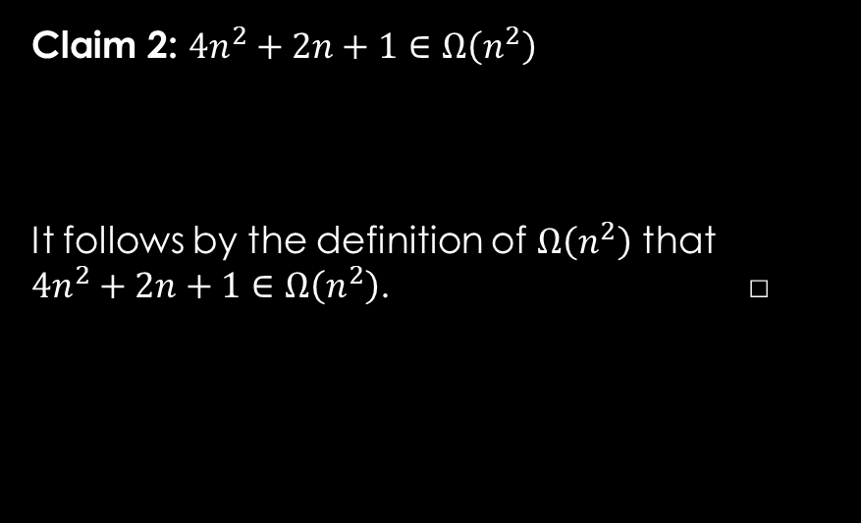
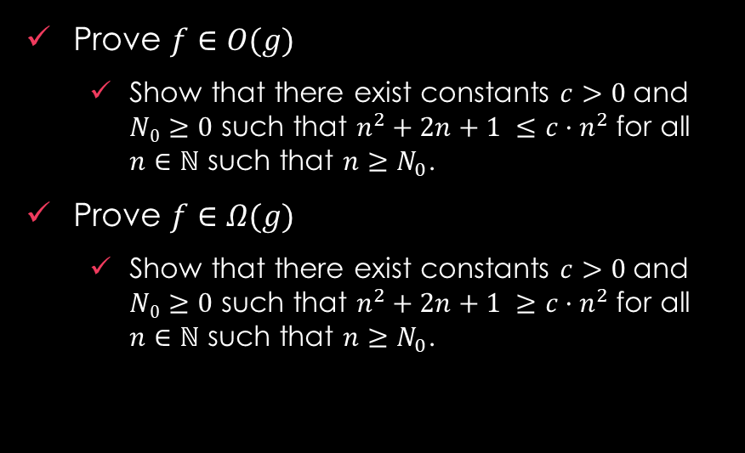
Question 1.a: prove that $f∈Θ(g)$
Work Area:
Background: To prove $f∈Θ(g)$, we need to:
Claim 2: $4n^{2}+2n+1∈Ω\left(n^{2}\right)$
It follows by the definition of $Ω\left(n^{2}\right)$ that $4n^{2}+2n+1∈Ω\left(n^{2}\right)$. □
Prove $f∈O(g)$
Show that there exist constants $c>0$and $N0≥0$ such that $n^{2}+2n+1 ≤c·n^{2}$for all $n∈ℕ$ such that $n≥N_{0}$.
Prove $f∈Ω(g)$
Show that there exist constants $c>0$and $N0≥0$ such that $n^{2}+2n+1 ≥c·n^{2}$for all $n∈ℕ$ such that $n≥N_{0}$.

Slide 10

Question 1.a: prove that $f∈Θ(g)$
Work Area:
Background: To prove $f∈Θ(g)$, we need to:
Since $4n^{2}+2n+1∈O(n^{2})$ and $4n^{2}+2n+1∈Ω\left(n^{2}\right)$ by Claims 1 and 2, respectively,
it follows by the “alternative definition of $Θ(g)$ that $4n^{2}+2n+1∈Θ(n^{2})$.
Prove $f∈O(g)$
Show that there exist constants $c>0$and $N0≥0$ such that $n^{2}+2n+1 ≤c·n^{2}$for all $n∈ℕ$ such that $n≥N_{0}$.
Prove $f∈Ω(g)$
Show that there exist constants $c>0$and $N0≥0$ such that $n^{2}+2n+1 ≥c·n^{2}$for all $n∈ℕ$ such that $n≥N_{0}$.

Slide 11
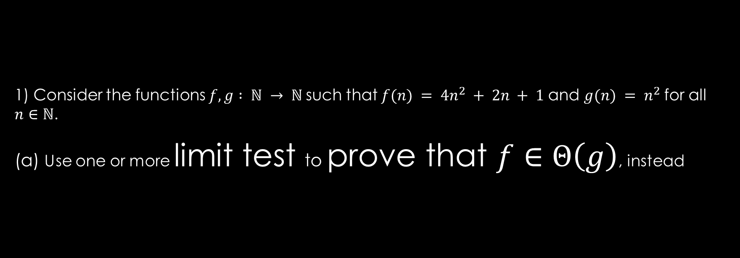

Question 1.b: limit test to prove that $f∈Θ(g)$
1) Consider the functions $f, g : ℕ → ℕ$such that $f(n) = 4n^{2} + 2n + 1$and $g(n) = n^{2}$for all $n∈ℕ$.
(a) Use one or more limit test to prove that $f∈Θ\left(g\right)$, instead

Slide 12


Question 1.b: limit test to prove that $f∈Θ(g)$
Work Area:
Background: To prove $f∈Θ\left(g\right)$ using Limits Test we need to:
Show that
$$\lim_{x→+∞}{\frac{f(x)}{g(x)}}$$
exists and is not $+∞$ and is $>0$.

Slide 13
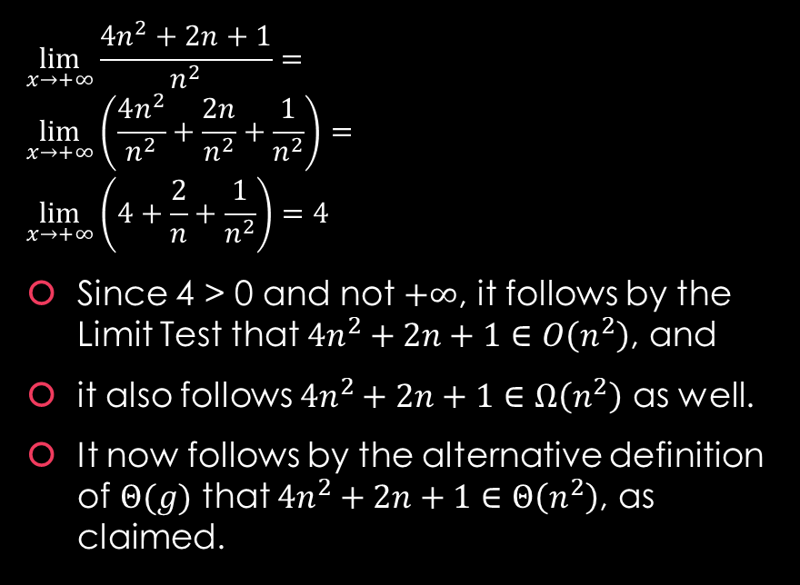

Question 1.b: limit test to prove that $f∈Θ(g)$
Work Area:
Background: To prove $f∈Θ\left(g\right)$ using Limits Test we need to:
$$\lim_{x→+∞}{\frac{4n^{2}+2n+1}{n^{2}}}= \\ \lim_{x→+∞}\left(\frac{4n^{2}}{n^{2}}+\frac{2n}{n^{2}}+\frac{1}{n^{2}}\right)= \\ \lim_{x→+∞}\left(4+\frac{2}{n}+\frac{1}{n^{2}}\right)=4$$
Since 4 > 0 and not $+∞$, it follows by the Limit Test that $4n^{2}+2n+1∈O\left(n^{2}\right)$, and
it also follows $4n^{2}+2n+1∈Ω\left(n^{2}\right)$ as well.
It now follows by the alternative definition of $Θ(g)$ that $4n^{2}+2n+1∈Θ\left(n^{2}\right)$, as claimed.
Show that
$$\lim_{x→+∞}{\frac{f(x)}{g(x)}}$$
exists and is not $+∞$ and is $>0$.

Slide 14


Question 2: Prove if $f∈O(g)$ and $g∈O(h)$then $f∈O(h)$
2) Suppose that $f, g, h :ℝ→ℝ$ are asymptotically positive functions. Prove that if $f∈O(g)$ and $g∈O(h)$then $f∈O(h)$

Slide 15
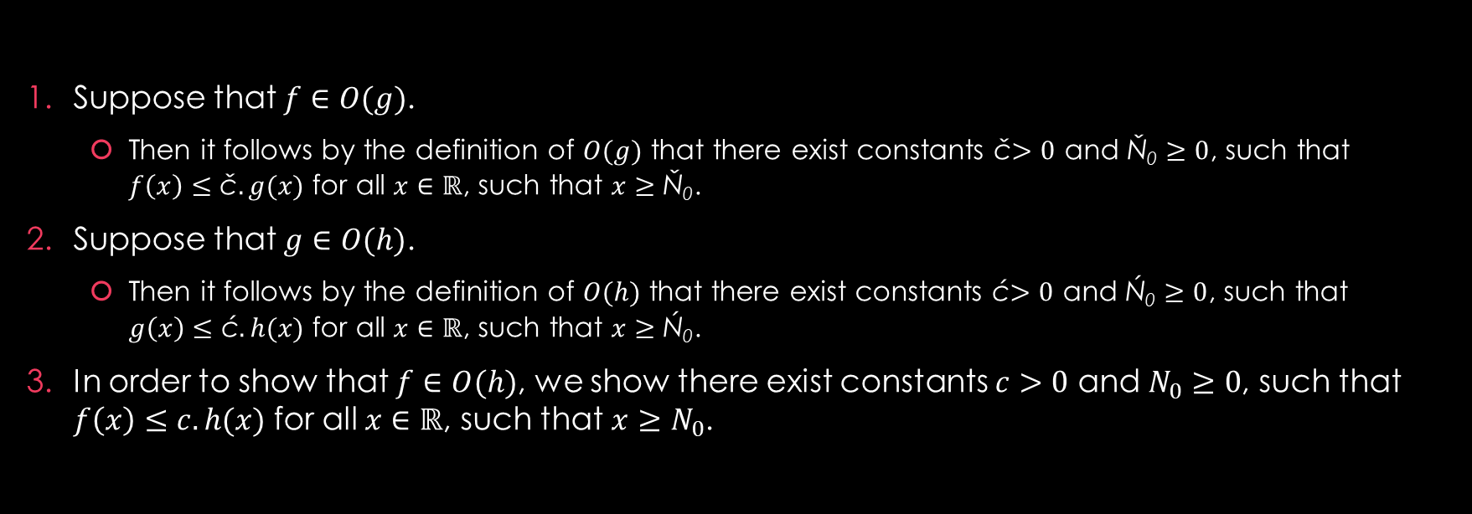
Question 2: Prove if $f∈O(g)$ and $g∈O(h)$then $f∈O(h)$
Suppose that $f∈O(g)$.
Then it follows by the definition of $O(g)$ that there exist constants č$>0$ and Ň₀ $≥0$, such that $f\left(x\right)≤\text{č}.g(x)$ for all $x∈ℝ$, such that $x≥\text{Ň}\text{0}$.
Suppose that $g∈O(h)$.
Then it follows by the definition of $O(h)$ that there exist constants ć$>0$ and Ń₀ $≥0$, such that $g\left(x\right)≤\text{ć}.h(x)$ for all $x∈ℝ$, such that $x≥\text{Ń}\text{0}$.
In order to show that $f∈O(h)$, we show there exist constants $c>0$ and $N_{0}≥0$, such that $f\left(x\right)≤c.h(x)$ for all $x∈ℝ$, such that $x≥N_{0}$.

Slide 16
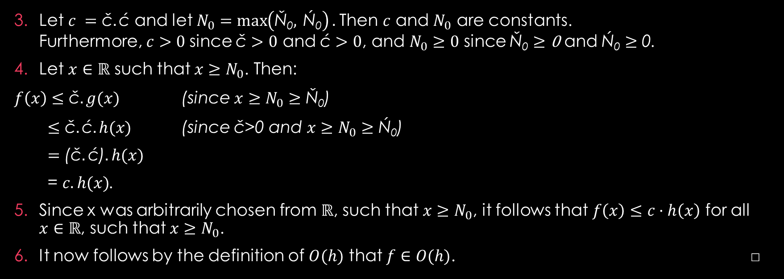
Question 2: Prove if $f∈O(g)$ and $g∈O(h)$then $f∈O(h)$
Let $c =\text{č}.\text{ć}$ and let $N_{0}=\max\left(\text{Ň}\text{0}, \text{Ń}\text{0}\right).$Then $c$ and $N_{0}$ are constants. Furthermore, $c>0$since $\text{č}>0$ and $\text{ć}>0$, and $N_{0}≥0$ since $\text{Ň}\text{0}≥\text{0}$ and $\text{Ń}\text{0}≥\text{0}$.
Let $x∈ℝ$ such that $x≥N_{0}$. Then:
$f\left(x\right)≤\text{č}.g(x)$ (since $x≥N_{0}≥\text{Ň}\text{0}$)
$≤\text{č}.\text{ć}.h(x)$ (since $\text{č}$>0 and $x≥N_{0}≥\text{Ń}\text{0}$)
$=$ ($\text{č}.\text{ć}$)$.h(x)$
= $c.h(x)$.
Since x was arbitrarily chosen from $ℝ$, such that $x≥N_{0}$, it follows that $f\left(x\right)≤c·h\left(x\right)$ for all $x∈ℝ$, such that $x≥N_{0}$.
It now follows by the definition of $O(h)$ that $f∈O(h)$. □

